Slide 1
The Effect of Effluent Pipe Discharge on Dry Run Creek
Benny Harken & Michael Stebbins

Slide 2
Goals
For our project we wanted to see how effluent pipes discharge effects the water quality of Dry Run Creek.

Slide 3
Methods
We chose 3 different sites
ROTH
University Ave
Towers
At each site we sampled 3 different sets of water
Above
Effluent
Below

Slide 4
Methods
We sampled 6 different parameters
pH
Total dissolved solids
Conductivity
Temperature
Dissolved oxygen
Turbidity

Slide 5
ROTH
Our first location that we took samples from is located near the footbridge going across Dry Run Creek near the Well Monitoring Station
The effluent pipe runs from Married Student Housing into the creek

Slide 15
Results
Total dissolved solids and conductivity are directly related
Effluent had slight effect on pH, TDS, and Conductivity

Slide 16
University Avenue Bike Trail
Our second location is located under University Ave. right next to the Bike trail that runs under it which is located next to the Cedar Falls Lutheran Home
The effluent pipe is located on the East side of the creek under the bridge

Slide 26
Results
Total dissolved solids and conductivity are directly related
Effluent appeared to have virtually no effect on the stream

Slide 27
Towers Location
Our third location is located near Dancer and Rider under Campus Street
The effluent pipe is located under the bridge that crosses Dry Run Creek

Slide 29
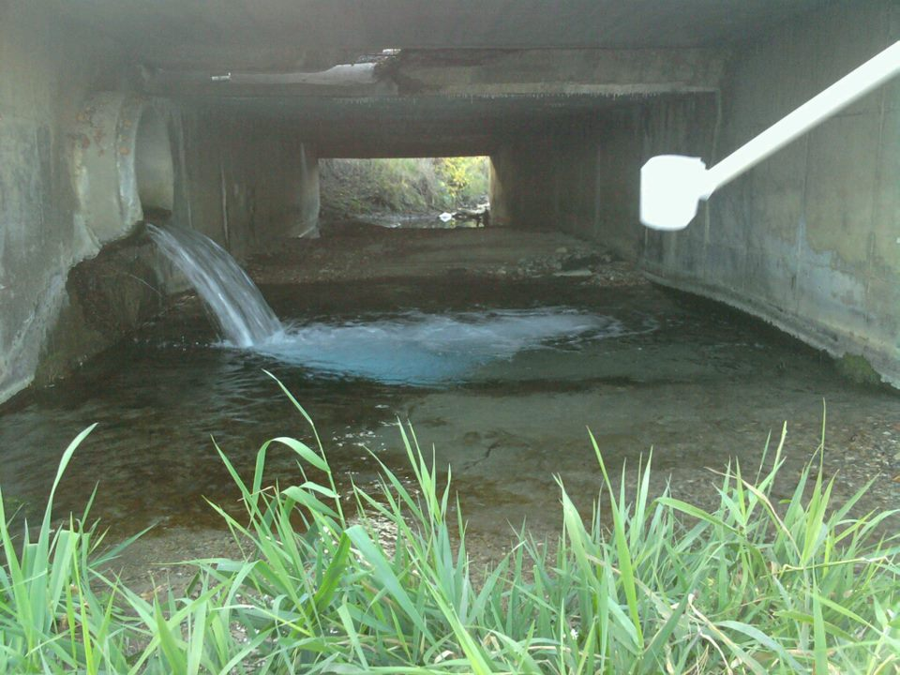

Slide 36
Results
Total dissolved solids and conductivity are directly related
Effluent had more significant effect on pH, temperature, and turbidity
Little effect was noticed for DO, conductivity, and TDS

Slide 37
Conclusion
Towers site had largest effect on stream
Largest volume of effluent water
Overall there was no large effect for the parameters we sampled
Temperature differences could have been due to shaded vs non shaded areas of the stream
Rain greatly reduces the conductivity and total dissolved solids while increasing turbidity
Snow had no effect

Slide 38
Questions?

